Slide 1
Westernisation and Urbanisation
Dr J Balamurugan

Slide 2
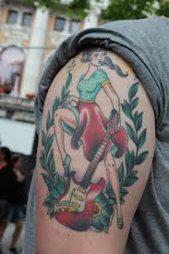

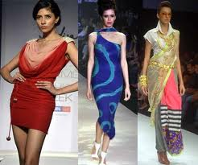
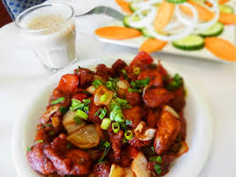

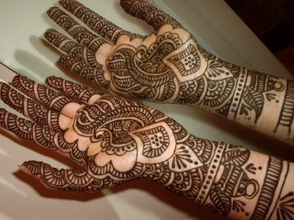
Westernisation

Slide 3
Introduction
Westernization is a process in which societies adopt western cultures in areas such as industry, technology, law, politics, economies, lifestyles, clothing, language etc.
Today, there are many people who are westernizing themselves among many cultures.
Westernization has become common in the world especially in India.

Slide 4
Introduction
People normally get a plastic surgery to look western is because it gives the back a round and a perkier shape, it also straightens hair.
People want to change themselves like this because they are not satisfied of the way they are.
They also think that being western is superior, and because they have a dominant history.

Slide 5
Introduction
The role ‘Westernisation’ has been very significant in understanding the socio-cultural changes of modern India.
British rule produced radical and lasting changes in the Indian society and culture.
The British brought with them, new technology, institutions, knowledge, beliefs and values.
Theses have become the main source of social mobility for individual as well as groups.

Slide 6
Meaning
M.N. Srinivas (1962) pioneer of sociology in India has used the term ‘westernisation’ to indicate the change, which took place in India during the British rule in the 19th and early 20th centuries.
Westernisation implies changes in dress, style of eating, manners etc. The change in the medium of instruction.
It started having its impact on the elite because they studied secular subjects with English as medium of instruction.
In as much as modernisation in India has come about due to westernisation.

Slide 7
Features of Westernisation
In comparison with Sanskritisation, Westernisation is a similar concept.
It implies an active concern for the welfare of all human beings.
It not only includes of new institutions but also fundamental changes in old institutions.
The form of pace of Westernisation of India varied from region to region and from one section of population to another.
It pervades political and educational fields also.

Slide 8
Characteristics of Westernisation
1. It is inclusive as it can accommodate various outside elements.
2. It is complex as it includes many aspects such as behaviours aspect, knowledge aspect etc.
3. It is many layered for it occurs in many levels.
4. Emphasis is given more on humanitarianism and rationalism.
5. Westernisation primarily focuses on cultural changes.
6. Westernisation results in the introduction of new institutions and brings changes in the old institutions.

Slide 9
Westernization impact on the Indian culture.
This country has a population of more than 1 billion and is a culture in which there are more than 700 languages spoken.
This culture however, is now being impacted by westernization and everything is slowly changing and is becoming western.
The Indian culture is ones of the oldest and the richest cultures however, now that the western culture is kicking in, e.g. goods, festivals, dressings, foods etc.,
The western culture is that it is replacing itself with the Indian culture.

Slide 10
Negative impacts of westernization on the Indian culture
Dressings.
Festivals.
Foods
Language
Lifestyles and People
Music

Slide 11
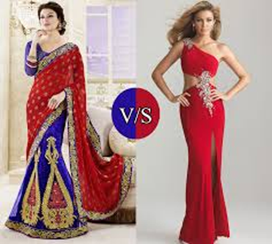
Dressings
Westernization is ruining the traditional clothing of the Indian culture.
For example, in India, the traditional dressing is sari, dhoti and kurta however, today there are lots of people wearing more of a western clothing like jeans, tee-shirts and girls are wearing short skirts tops etc.
In India, there is approximately 25% of western clothing.
The change of fashion in India is now leading to reduction of the importance of the Indian culture to many people.

Slide 12
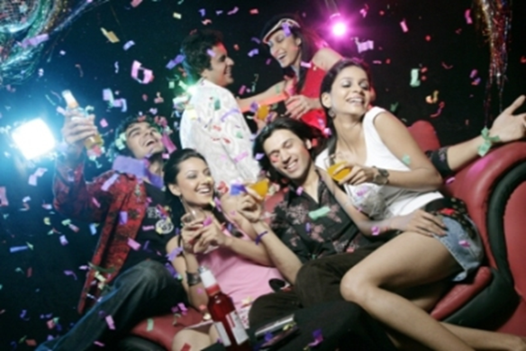
Festivals
The western culture is impacting on the Indian festivals in may ways too.
All Indians greatly celebrate their festivals every year and enjoy them very much.
Today, large numbers of people in India are not celebrating their own festivals like Holi or Diwali, but instead, they are celebrating more of western cultures like Christmas or Halloween.
Also, in the Indian religion, no boy or girl are allowed to date each other however, today in India, many youngsters are breaking these laws and are celebrating valentines day and are not alert of their religion and this is reducing the value of the Indian religion for them.

Slide 13


Foods
The Indian plate has welcomed many western foods (e.g pizza, burgers, steak tacos etc.), and Indian foods like Golgapa, curry etc., are being less popular in India, however are becoming common in Europe while the western foods are growing stronger and are becoming more popular in India.
Western foods contain too much fat and this causing the obesity rate in India to increase.
In the Indian religion, you are not allowed to eat pork or meat however, since the western foods have kicked in, many Indians are no longer respecting their religion and are eating things against their religion.
This is causing the value of the Indian religion to decrease and is changing many people's lifestyles. Today in India, there are more western restaurants like KFC, or Mac Donald's compared to the Indian restaurants there are.

Slide 14
Language
In India, there are more than 700 languages spoken.
However, many of these mother tongue languages are beginning to fade away.
As usual, to get a good job, you must know the basic language (English) or other additional ones.
So many people today are focusing on these languages and are forgetting about their mother tongue thus, this is making their region less important.

Slide 15
Lifestyles and People
Westernization has changed many peoples lifestyles. Now, there is no particular lifestyle that is Indian.
Most things have changed like respect to the young ones and elders, importance of a family, marriage making, clothing, festivals, foods, names, languages and even getting a plastic surgery to look more western.
People are changing themselves and are trying to adapt like western people.

Slide 16
Conti..
Westernization is also reducing the equality of lifestyles in India.
In the Indian culture, in order to visit a temple, you must have the right clothing although, it is shocking to see that today, there are many teenagers who are dressing as modern people e.g stylish haircuts, jeans, tee-shirts etc., when entering a temple.
In the Indian culture, people had respect for the young and elders however, since the western culture has arrived, the respect had gone and now the behaviors of many people have changed.

Slide 17
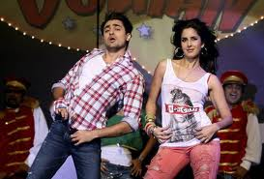
Music
The Indian music has changed greatly due to in taking of the western culture.
Indians have their own traditional music and instruments like flute, drums, etc.,
however, today they are using different instruments like guitars to make their music and now, Indian songs sound completely different and are nothing like what they sounded before.

Slide 18
Positive Impacts of westernization on the Indian culture.
Modernization
Public Health
Labor
Education
Films and movies

Slide 19
Modernization
The western culture has impacted on India in many negative ways however, it has also influenced India in many ways too.
For example, it is making India more modern. The Indian culture is a very old culture and is staying the same however, now the western culture is changing it to become more modern.
Today, the western media is now making many people in India especially teenagers dressing more modernly like jeans, tee shirts etc.
Modernization has also enabled to increase the economic growth of India.

Slide 20
Public Health
Due to westernization influence, sanitation and public health has improved greatly in India.
Many western doctors have immigrated into India and have made medicines which have helped reduce sicknesses, diseases in large parts because health care has become accessible.

Slide 21
Labour
The presence of western traders in India have increased the demands for goods and services in India.
As a result of that, Indian artisans, craftsmen and weavers have employed.
These artisans and craftsmen have grown in numbers and now the Indian labour force and become more skilled and handy.

Slide 22
Education
Westernization has also benefited areas of education in India.
When the British occupied India, they build many schools throughout the country and this made the literacy increase and the poorest class of society had access to knowledge.

Slide 23
Films and movies
Westernization has brought media as well in India.
For example, in America, India now has a famous movie making media called ‘Bollywood’ which came from Hollywood in America.
Bollywood’s films now traditionally feature India, its culture, tradition and religion.
Bollywood is now quiet popular in India and many people know about it.
So media in India has also improved due to the western culture.

Slide 24
So is westernization a good thing or a bad thing?
Westernization has brought many negative impacts on India however, it has also brought many benefits as well although, there are more advantages of westernization compared to the disadvantages.
Still, India should take care of this globalization because in the future, it will change India and destroy it's religion, culture and tradition.

Slide 25
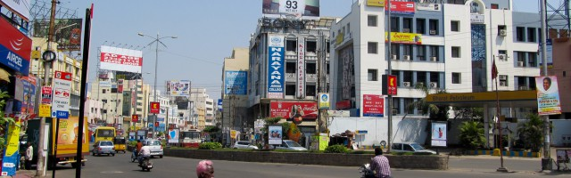
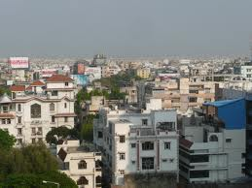
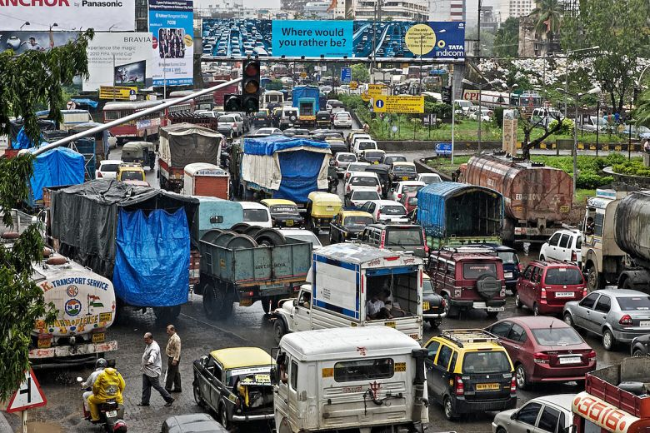
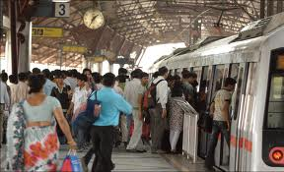
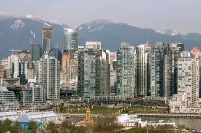
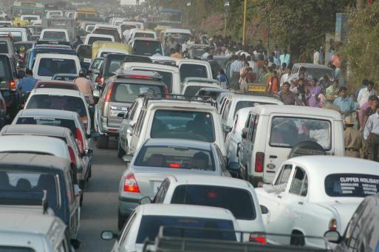
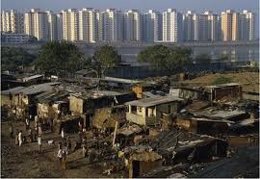
Urbanisation

Slide 26
Introduction
What is an ‘urban area’?
The term is used in two senses –
Demographically, the focus is on the size and density of population and nature of work of the majority of the adult males.
Sociologically, the focus is on heterogeneity, impersonality, interdependence and the quality of life.

Slide 27
Classification of Urban
In Census of India, 2001 two types of town were identified
a) Statutory towns: All places with a municipality, corporation, cantonment board or notified town area committee, etc. so declared by state law.
b) Census towns: Places which satisfy following criteria :-
i) a minimum population of 5000
ii) at least 75% of male working population engaged in non agricultural occupation
iii) a density of population of at least 400 persons per sq km

Slide 28
Meaning
Urbanization concerns the movement of population from agricultural to industrial work and from rural to urban places of residence.
People are attracted to the city by vision of a better life, or they feel compelled to leave rural places because they are disadvantaged there.
For most such immigrants, urbanization means a source of change from one way of life to another.
As such new classes and status functions are derived in social life. New forms of mass media like the radio, T.V., newspapers, magazines etc., bring a lot of change in rural social life.

Slide 29
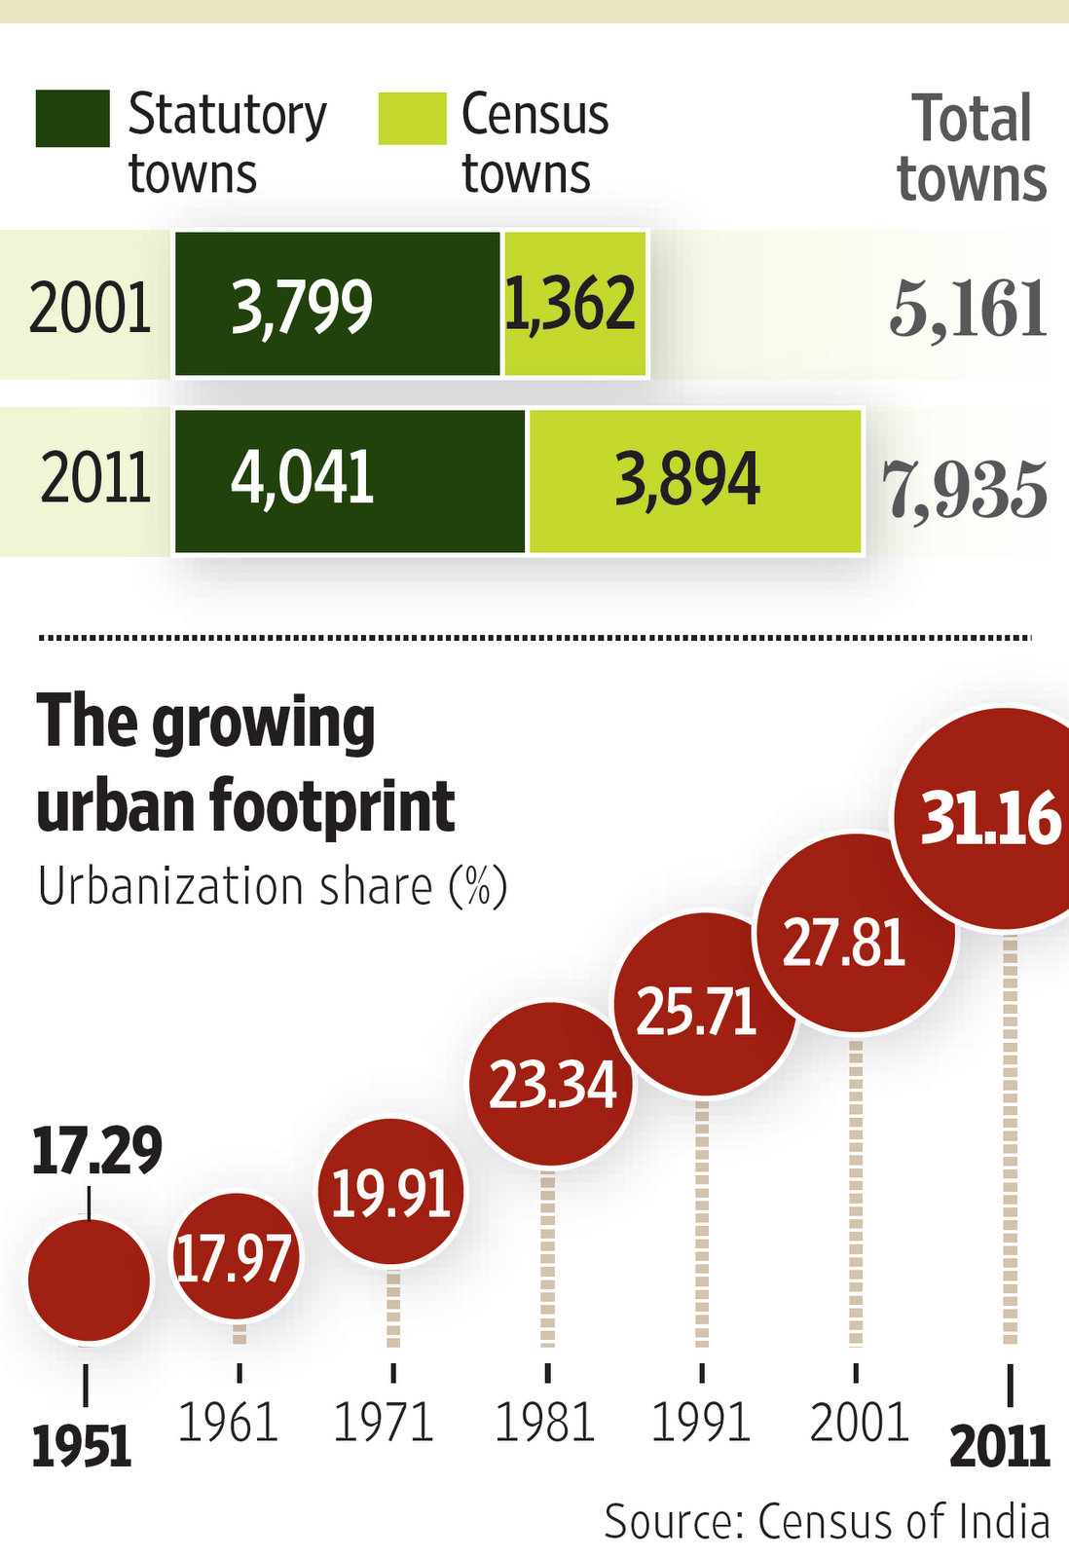
Level of Urbanisation in India

Slide 30
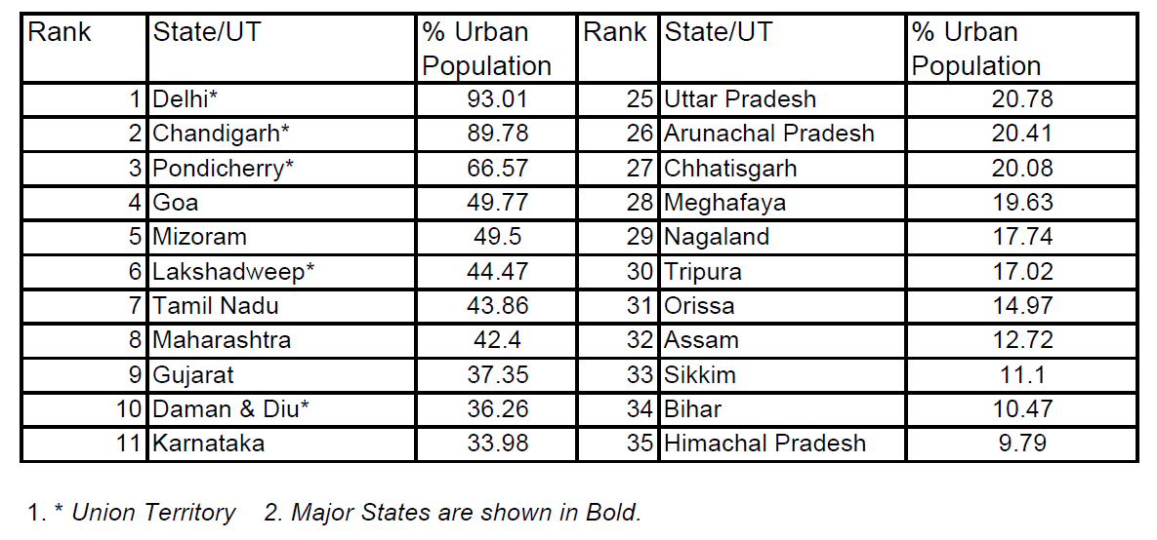
Ranking of States by level of Urbanisation

Slide 31
Growth of cities
Surplus Resources
Industrialisation and Commercialisation
Development of Transport and Communication
Economic Pull of the City
Educational and Recreational Facilities

Slide 32
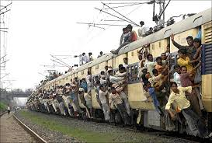
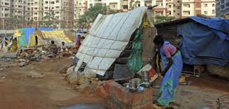
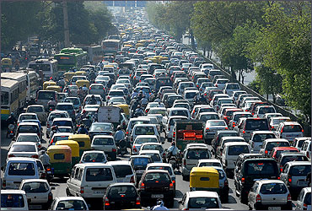
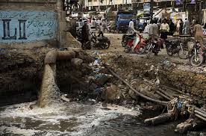
major problems of urbanisation in India
Overcrowding
Housing
Unemployment
Slums and Squatter Settlements
Transport
Water
Sewerage Problems
Trash Disposal
Urban Crimes
Problem of Urban Pollution!

Slide 33
Impact of Urbanisation
The multiculturalism of today's cities contributes to increased tolerance, better quality of life, and socio-cultural motivation;
At the same time, it often contributes to social tensions, interethnic determined and cultural conflicts.
People coming from rural areas have been suffer from the isolation, lack of technologic connection, poor health, poverty, unemployment and inadequate housing in urban.
Urbanization is encouraged socially and culturally through the media.
All of which undoubtedly create the psycho-socio problems among people.

Slide 34
Thank you

